Slide 1

Mapping and Practical Skills

Slide 2
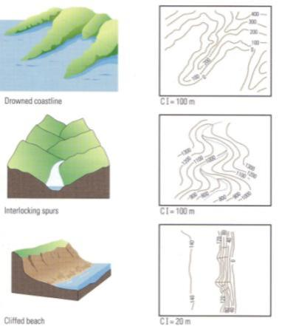
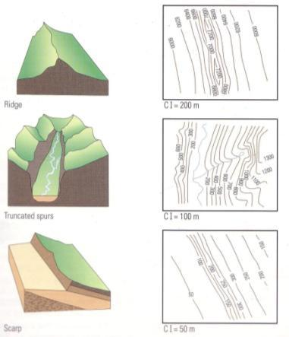
Interpreting Landforms
Landforms can be identified from contour shapes

Slide 3
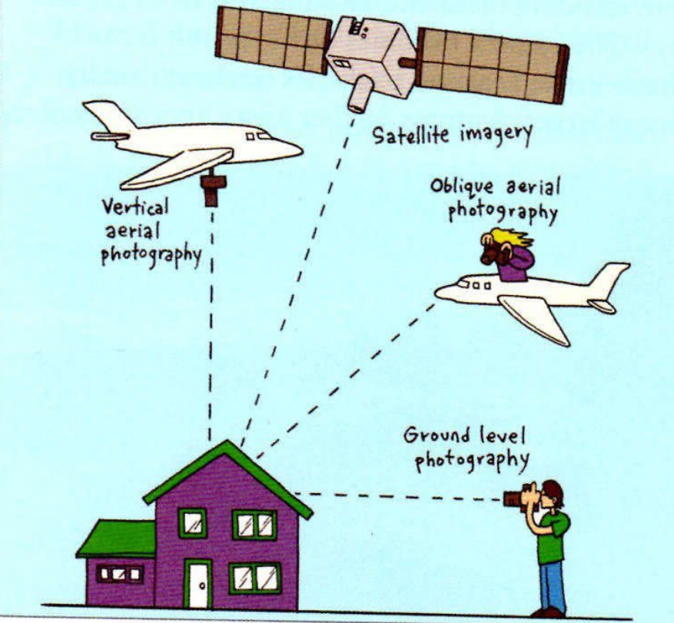
Different types of Photographs

Slide 4
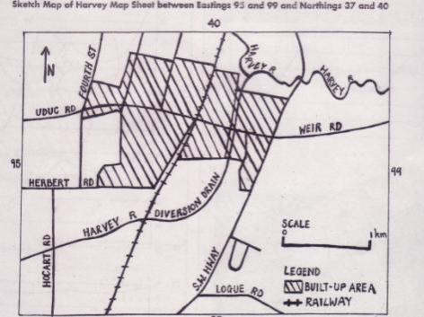
Sketch maps
Sketch maps help identify the major features of a topographic map and the patterns that the features form
Draw a frame in the same proportion of the map / scene indicating the relevant grid lines.
Draw in the dividing lines get the horizon, roads/rail etc
Show minor features
Sketch & label the distribution of the relevant features e.g landforms
Shade in zones eg vegetation/urban
Include a legend and scale
Label the sketch map with a title and north point
MUDMAP

Slide 5

Essential Elements of Sketch Maps
REMBEMBER BOTLSS
Border
Orientation (north point)
Legend
Title
Scale
Source
Make labels clear and place them outside the sketch if necessary

Slide 6
NOTE
Do you remember the important elements of a sketch map?
See if you can write them in your file without looking at any notes.

Slide 7
Mean, Median, Range
Mean – average of the values
Median – when ranked in order lowest to highest it’s the middle value
Range – the difference between the highest and lowest values
For numbers 2, 2, 2, 3, 4, 5, 7, 7
Mean is…….
Median is……..
Range is…………
32 divided by 8 = 4
3.5 (3 plus 4 equals 7 divided by 2)
5 (calculation of 7 subtract 2)

Slide 8
Distribution
How is it arranged?
is the arrangement of objects viewed at a variety of scales.
These may be at or near the Earth or beyond
This is used to describe WHERE everything is within a space

Slide 9
Spatial Association
This goes with that..
is the degree to which two or more things are similarly arranged over space or the location of one thing is dependant on another.
spatial association compares distribution patterns and may be:
strong e.g. location of elderly people and aged care facilities
weak e.g. location of cabinet making factories and steal fabrication plants (both occur in industrial areas)
non existent e.g. location of fish and chip shops and football ovals

Slide 10
Spatial Interaction
How strongly related?
is the strength of the relationship between phenomena in the environment and the degree to which they influence each other.
Over time, the impact of people on the environment changes and the environment, in turn, changes people.

Slide 11
Spatial Change Over Time
Before and after
is the degree to which an area has had its geographic characteristics altered over a period of time – to be determined and stated
change occurs at varying rates at different times and may be considered at different scales.

Slide 12
Region
Common ground
is a definable area on the earth’s surface which contains one or more common characteristics e.g. a climatic region
Regions vary in size and may be part of the natural or human environment

Slide 13
MAPS & GRAPHS
List examples
Discuss as a pair

Slide 14
Choropleth Map
These types of maps use areal shapes or polygons to show spatial information.
The most common method of presentation is to use colours or shading based on the number of categories into which the data has been classified. The polygon is often based on an area for which statistical information is readily available, such as a suburb, local government area or a country

Slide 15
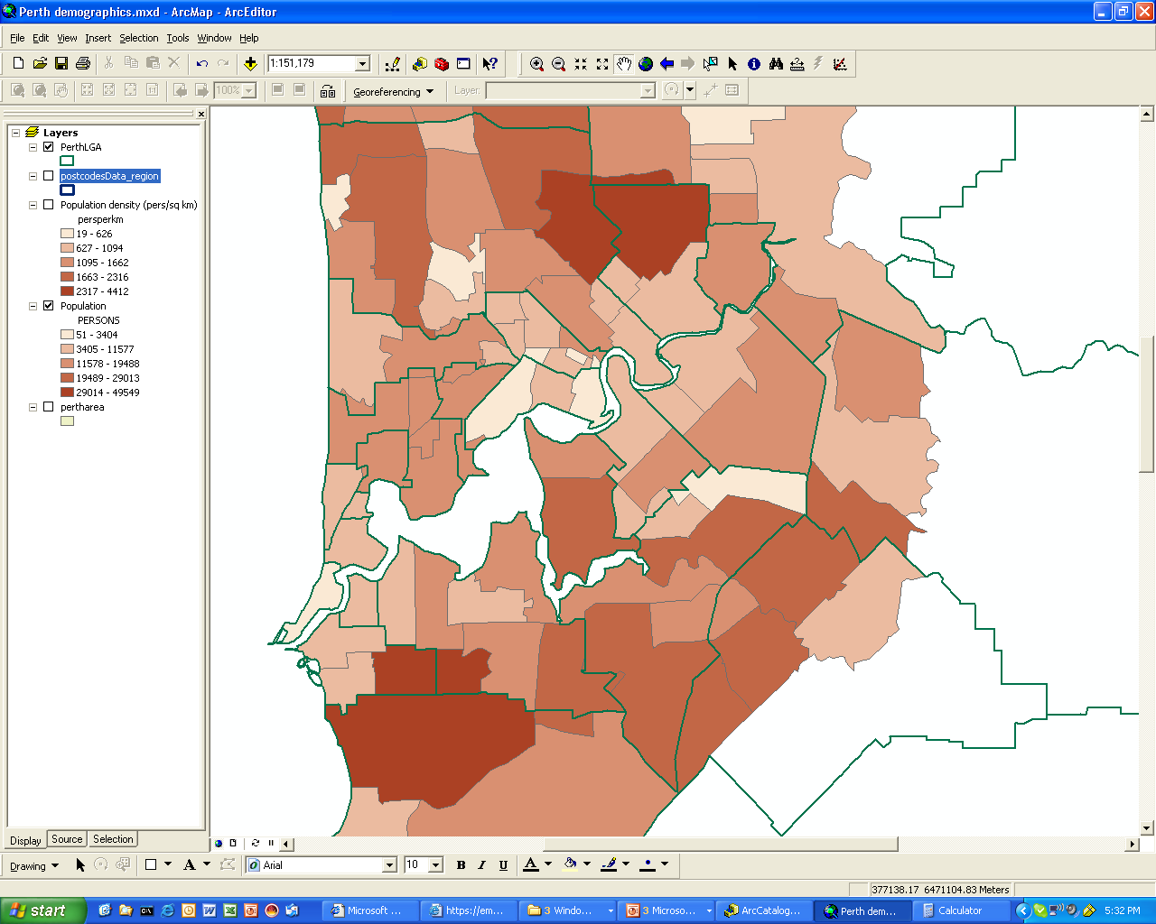
Choropleth map
This choropleth map shows the population number for local government areas of Perth

Slide 16
Isolines
To map particular characteristics of an area, such as elevation, the amount of rainfall, or temperature ISOLINES are often used.
An ISOLINE is a line on a map that connects points of equal value
This value must be stated to be relevant

Slide 17
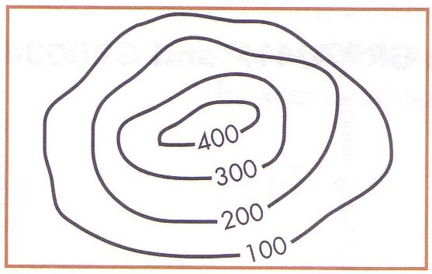
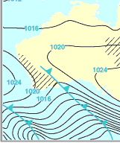
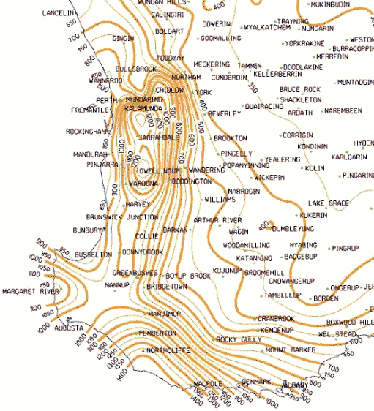
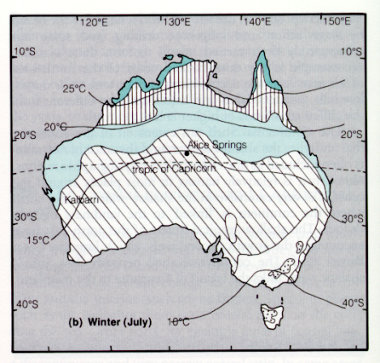
ISOLINES on maps joining places of equal…
height/elevation …………………………….......
pressure………………………………………………..
rainfall……………………………………………………
temperature………………………………………..
Contours
Isobars
Isohyets
Isotherms

Slide 18
Isopleth Mapping
Isopleth or isoline maps show the patterns and variations of data that is continuous. An example of this type of data is air pressure. There is air pressure everywhere on the earth’s surface. It is continuous.
We can map air pressure by taking sample recordings and then plotting these results for different locations. Once the data has been plotted, the next step is to draw lines that connect locations with the same air pressure. The pattern of lines then reveals the areas where air pressure is higher or lower

Slide 19
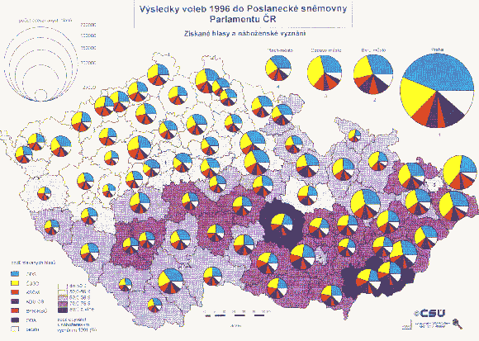
Proportional Symbol Maps
As the name implies, symbols (most often circles) are drawn proportional in size to the size of the variable (e.g. employment change) being represented. Proportional symbol maps are not dependent on the size of the area associated with the variable. In other words, on a proportional symbol map of Europe, tiny Liechtenstein would have the same visual importance as Spain if their unemployment values were the same. This is not the case with a choropleth map.
An example of proportional circles is shown on the Czech Republic Voting Register map

Slide 20
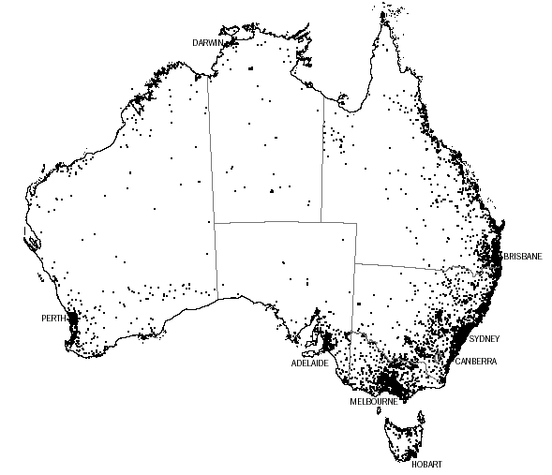
Dot Maps
A dot map uses a dot to represent the number of a phenomenon found within the boundaries of a geographic area. In addition, the cartographer usually attempts to show the pattern of distribution within the area by placing the dots where the phenomenon is most likely to occur.
Each dot = 1000 people

Slide 21
Graphs
There are a number of different types of graphs. Some common graphs in Geography include:
Population pyramids
Climate graphs
Pie charts
Linear graphs
Column graphs
Histograms

Slide 22
Remember
When interpreting graphs….refer to specific figures and always use the date range.
When writing about data….check to see if things have double, tripled or halved, steadily or dramatically increased…etc.

Slide 23
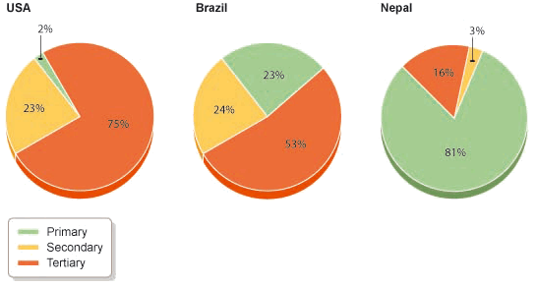
Pie charts
Pie charts are used for showing how something breaks down into its constituent parts.
The pie charts below show differences in the split between primary, secondary and tertiary employment in USA, Brazil and Nepal.
Question: Compare the breakdown of the three employment types in the three countries shown in the pie chart above

Slide 24
In this example the circles are the same size. It would also have been possible to make the size of the circle proportional to the size of each country's labour market. Pie charts like this are sometimes called proportional circles.

Slide 25
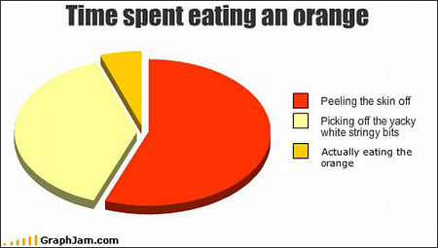
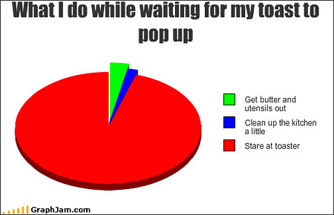
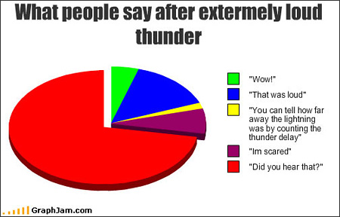
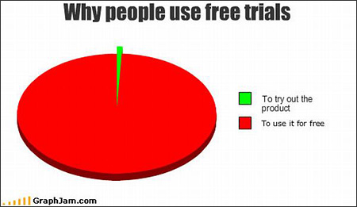

Slide 26
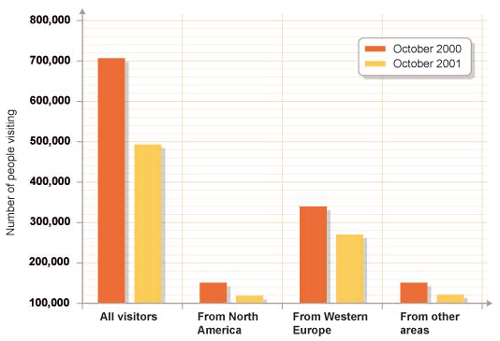
Bar graphs
The chart below compares the tourism data for the UK in October 2001 with October the previous year. The graph shows how tourism declined after the terrorist attack in America in September 2001.

Slide 27
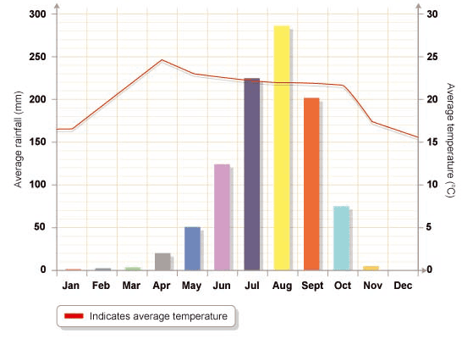
Climate graphs are a combination of a bar graph and a line graph. Temperature is shown on a line graph, with the figures being shown on the right side of the graph. Rainfall is shown by a bar graph, with the figures being shown down the left side of the graph.
Timbuktu climate graph - shows average annual rain & temp in Timbuktu in Mali.

